Slide 1
3-D Jewelry Creations
Erick Corona-Ramirez
Miguel Guzman Valle
Stephanie Gonzalez
Xue Feng
Yijing Cheng

Slide 2
Business Idea
With the increase use of Jewelry by people and many trying to get something that looks nice at an affordable price. Our goal as a company to satisfy those wants with the use of 3D printing to created a low cost and affordable product for people. We not only provide luxury jewelry, but also affordable pieces in our collection in order to reach a larger demographic. We will achieve this while offering in house custom designs, and customers can send their own design to have it made with materials that they want. With our only store being located in Pasadena, CA.

Slide 3
Competition
With not a lot of people using or having a 3D Jewelry store front and showing how personal a piece of jewelry can be by customizing to meet the customers requirements. The uniqueness of this idea gives us the competitive advantage towards other jewelry stores.
Competitive Rivalry
Threat of New Entrants
Bargaining Power of Buyers
Threat of Substitutes
Bargaining Power of Suppliers
Threat of New Entrants:
Low to medium
Many people can open online business to offer 3D jewelry but, we can handle this by offering fast service and save on shipping
Competitive Rivalry:
Medium
There are a few online 3D Jewelry businesses and some people would rather online than go in person but, we can handle this by offering lower prices than online and letting the customer come in store if they need help designing.
Pugster Inc. would be one of our competitive rivals as they are basically doing what we are going to do. Although, the area in which we would be located is a bit different but, still they will have more history.
Bargaining Power of Buyers:
Medium to High
By providing a service in helping the customer design the piece of jewelry it will give us the advantage on either making the customer return or have them tell others.
Threat of Substitution:
Low
There is already a few 3D Jewelry stores online plus who knows if there might be some with a store front in other countries. But within the area of our location there isn’t as many.
Bargaining Power of Suppliers:
Low
The only suppliers needed will be the wax for the jewelry. We will have our own manager in charge of fixing the 3D Printers incase anything goes wrong.

Slide 4
Role of Information Systems
The use of information system will allow us to collect data and apply it by understanding the demographic information of what people spend their hard-earned income. How much they spend in apparel/accessories (jewels/jewelry).
We will also get information about the competition and how they perform around that specific area and collect data of the expenses required to maintain the business. As well as to, inquire the need of the clients and what they would prefer to see in the store.

Slide 5
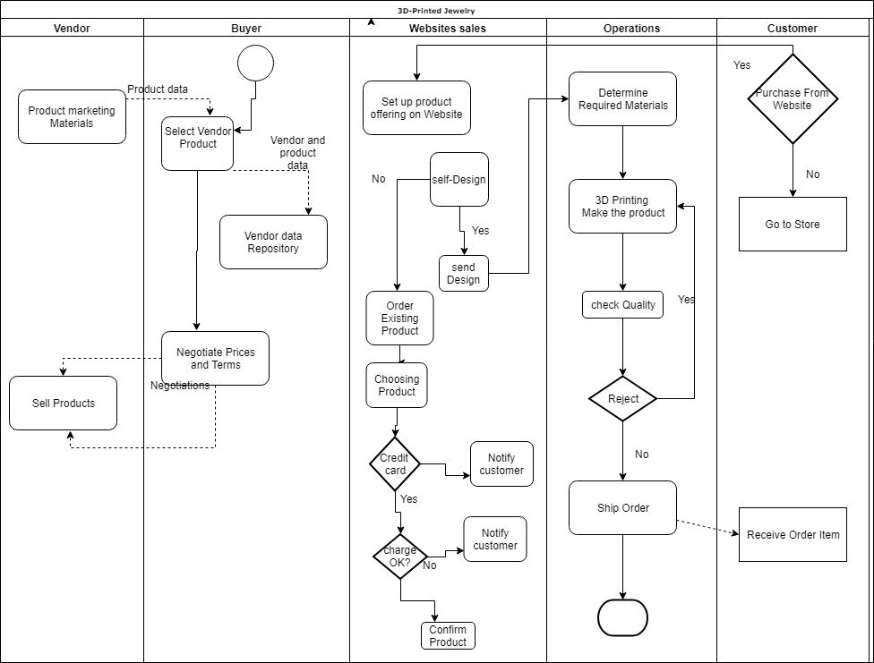
Role of Information Systems

Slide 6
Revenue
We will generate revenue through, up or down scaling the quality of the metals used in our jewelry. For example, if someone wants a ring since we 3-D print the Jewelry in house, depending on the customers’ need or want they can choose to have the rings band to be made from either silver, gold, or white gold on the spot. This allows us to reach a larger demographic of customers allowing us to generate high sales.
Another way to generate revenue is if the customer wants to add either gems or diamonds to their jewelry they can then talk to our jewelers for a more personal and tailored experience when designing their jewelry, the way they want. By doing this it also allows us to reach the luxury market of jewelry to help generate revenue.
Lastly, we could provide customers to design their jewels form scratch and creating their one of a kind one will help providing more revenue. This would attract people that one to have something unique.

Slide 7
Customers
Our mission is to provide good and reliable jewels and jewelry to all ages. That on itself it the main goal but, the specific ages we plan to target would be 12+ years old.
Reason behind targeting young people is because tend to want to follow fashion trends. Allowing us to create fashion Jewelry to meet this demand at affordable prices.
For young and older adults, besides the affordable designs, higher quality pieces would be at their reach, since the ability to request custom designs for each individual.
Also, our target customers would mainly be in the middle- and high-income class as they are more lightly to spend their extra income in appeals and goods.

Slide 8
Location Analytics-I
Our Process for the GIS analysis was by looking with areas with high people traffic. As well with areas that are around people with high to medium disposable income. Also knowing where others Jewelry relates stores are located and find an area in which there is still high traffic of people while keeping a good distance, so our business doesn’t overlap with the others.
The location of the store would be around Pasadena area near E Colorado Blvd, since that area is highly active and there’s a lot of commercial places around. It will attract people to the shops and those customers who are interested in jewelry would come into our shop out of curiosity and inspect our shop. Those who enter might purchase an item at the moment or might be interested to purchase later on.

Slide 9
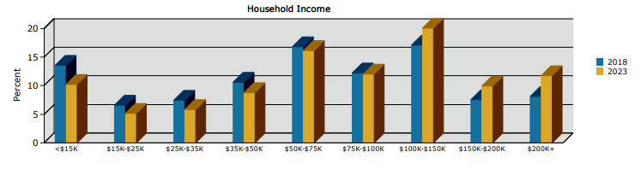
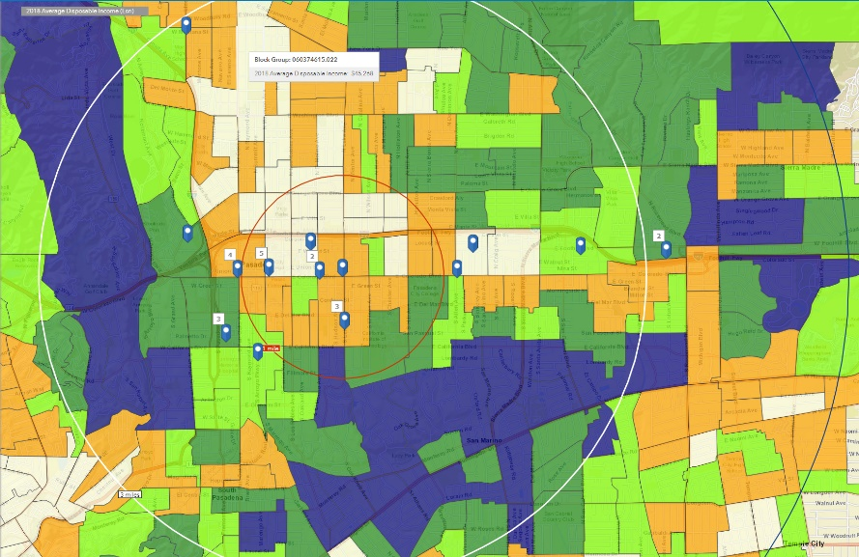
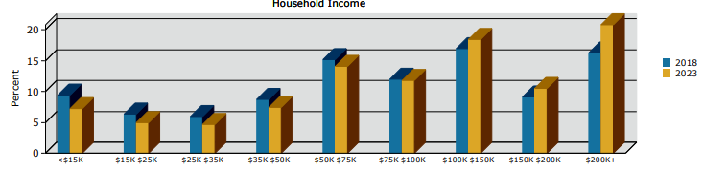
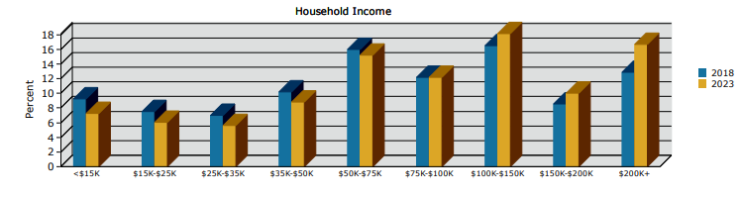
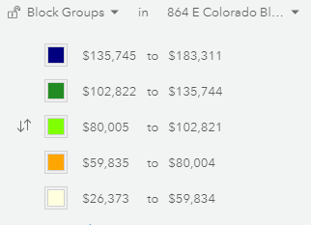
Location Analytics-II
Average disposable income
1 mile radius
3 mile radius
5 mile radius

Slide 10
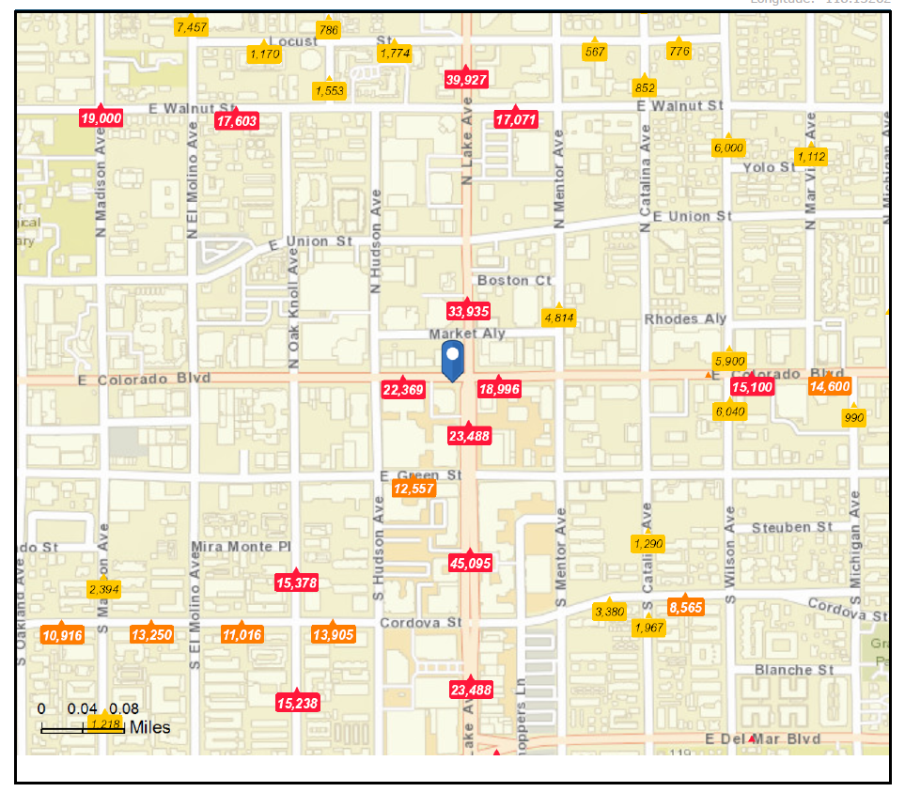
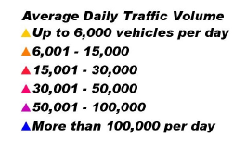
Location Analytics-III
The reason why we chose this location for the store is because of the high traffic of people around that area.

Slide 11
Location Analytics-IV
According to the first diagram, we could see that the areas with the average disposal income from $135,745 to $183,311 in 2018 is surrounded our location in the west and south. Also, on the second one, this location we chose for the store has a high traffic of people around that area. So by combining these two conditions, we believe that the high traffic situation would bring more customers with disposable income to visit our store.

Slide 12
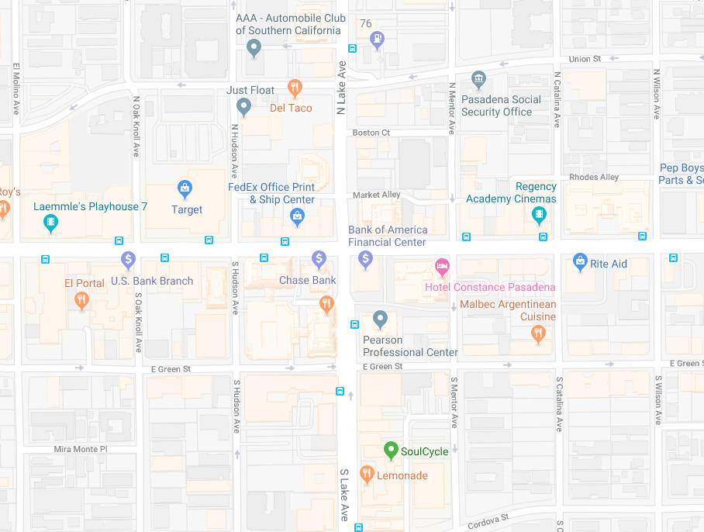
Location Analytics-V
Around - 864 E Colorado Blvd, Pasadena, California, 91101

Slide 13
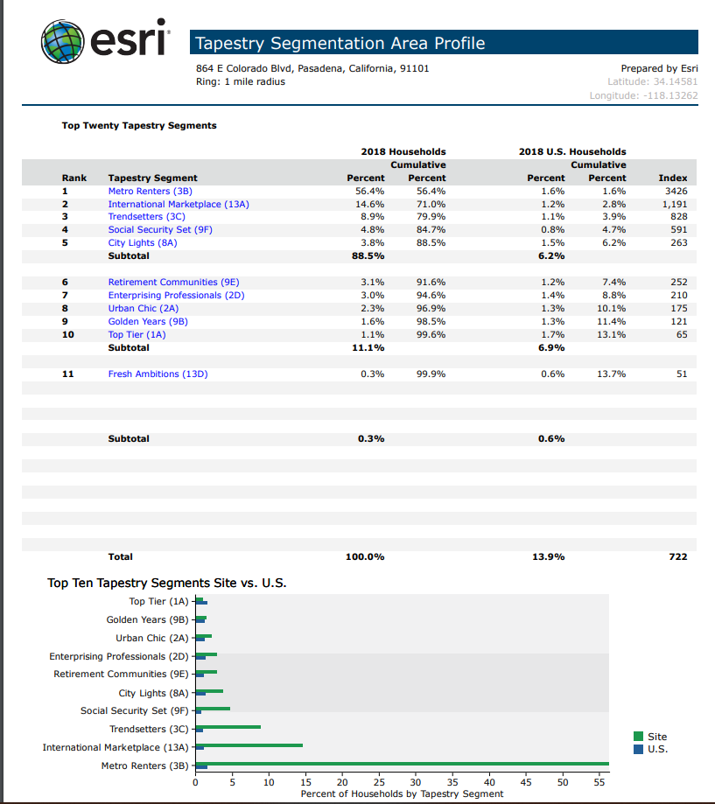
Location Analytics- VI
According to the tapestry report, over 50% of the population within our location satisfies our targeted customer’s age. Households in this location would increase by 580.
While the home value over $500K is 53%.
The Median Household Income is at a 4.45%, while the household income over $75K will keep increasing from 2018 – 2023.
All of the categories provided show the we would have good prospects with this location.

Slide 14
Marketing Strategy
The marketing strategy will be based on attendance (promotion with a booth). Show part of the jewelry collection and advertise their value.
Use of website which will allows us to increase visibility in the market, collect information and process orders.
Another option will be as the first one promotion using networks, art/jewelry galleries. Create relations with galleries that would be willing to exhibit some of the Stores pieces, which will allow people to know about the store and attract more customers.
Finally we will utilize social media to look at our target demographic audience and promote on there to help attract more customers and spread awareness.

Slide 15
Messaging Strategy
We are a small Boutique Brand with a big Vision for the Future. Our goal as a company is to utilize bleeding edge technology, such as 3-D printing, to construct Beautiful Jewelry that can be customized base on the customers needs.

Slide 16
Are you going to be profitable?
According to analysts at the Retail Owners Institute, the gross margin percent trends for jewelry businesses have stayed relatively consistent in recent years. Gross profit margin is calculated by subtracting the cost of goods from a business's revenues. In 2013, the gross profit margin for jewelry stores was 43.5 percent. In 2017, it was 42.6 percent.
https://smallbusiness.chron.com/percent-profit-margin-retailers-expect-jewelry-73996.html

Slide 17
Conclusion
We can conclude that 3-D Printing Jewelry would be successful.
With the use of 3D printers give one the ability to create different designs with the use of different material. The material will be used as a base model to either improve on the design or used as a mold for the final design. It facilitate and lower the cost of creating models for the final product.
At the same time, with using 3D modeling gives one endless of unique designs to create which would attract customers and people to the store. As the number of customer’s satisfied with their purchase increases it will not only help increase the business’s reputation but also, it would help increase our business in general.

Slide 18
Three Wows
One of the three WOWs we found
We found interesting the profit margin that Jewelry stores get.
Interestingly there are not many moving in providing and using 3-D printing technology for helping create the base of jewels or even using them.
Even though there are some business providing 3-D printing jewelry online. There are not many, to not mean at all a store location that sell them to the public allowing them to increase their revenue

